Slide 1
Battle of Neighborhoods
Today Tourism is one of the pillars of the economy.
Every city is unique in their own way and give something new.
Information above each city is so common regarding location of every place around the world on your fingertips which make it easier to explore.
Tourists always eager to travel to different places on the basis of available information, and the comparison (the part of the information) between the two cities always assist to choose the specific places or according to their choice.

Slide 2
Data acquisition and cleaning
1. Use below URL to get Neighborhood , Borough and Neighborhood Longitude and Neighborhood Longitude data set.
Toronto
https://en.wikipedia.org/wiki/List_of_postal_codes_of_Canada:_M
http://cocl.us/Geospatial_data
New York
https://cocl.us/new_york_dataset
2. Use Foursqaure API to get Top 20 Venus for each Neighborhood
3. One hot encoding is used to convert categorical ariable to binary variable

Slide 3
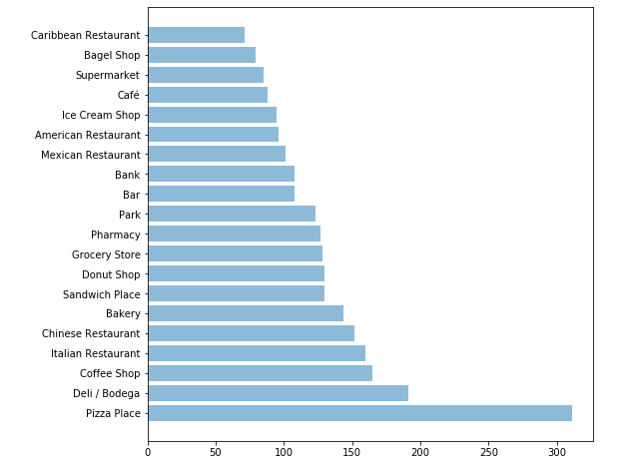
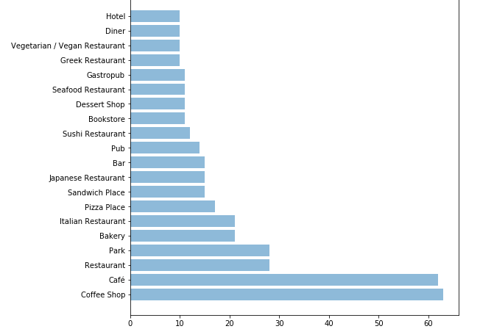
Visualization – Top 20 Venue Category
New York
Toronto

Slide 4
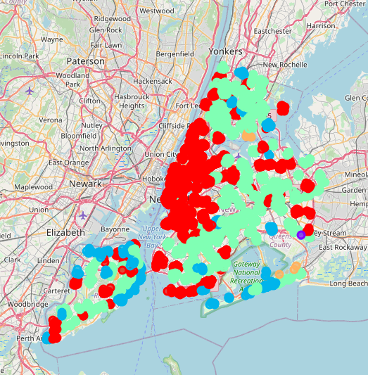
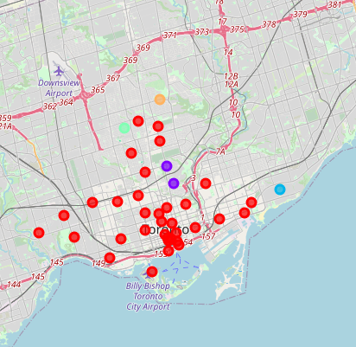
Clustering
New York
Toronto

Slide 5
Conclusion and Recommendation
Conclusion
Both cities has some similar and dissimilar features.
Similar Features: The neighborhoods are much similar in features like American and Asian Restaurant, Airport Terminal, Bakery, Bank , Bar, Basketball Stadium, BBQJoing, BoaterFerry,etc
Dissimilar Features: Aquarium, Beach, Beachbar,Circus,BikeRental/BikeShare,ComedyClub,etc
Recommendation
New York will be considered first to visit. The tourists have many options like Art Gallery, ArtMuseum, Beach and many more. Multiple choices for food like Mediterranean, Mexican, Middle Eastern and so on. Aquarium ,Beach Bar, Beer Bar , Entertainment Service and so on for sight seeing and entertainment. BaseballStadium, GolfCourse and so on for Sports lovers.

